Slide 1
Optimization Through Multithreading in C++

Slide 2
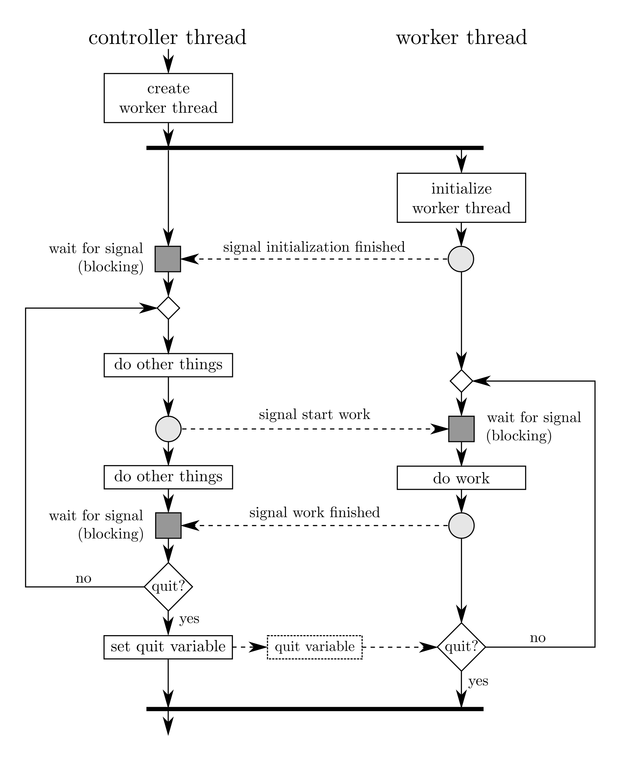
Multithreading in a Nutshell
Source: http://www.soa-world.de/echelon/2009/07/visualizing-multithreading.html
Notes:
Left Diagram:
-waiting: locks
-terminated: joining
-timed waiting: sleep, sets thread priority

Slide 3
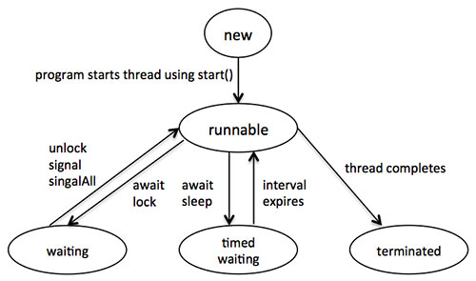
The Lifetime of a Thread
New
Runnable
Mutex lock (waiting)
Source: https://sahilgroverjava.wordpress.com/2014/02/17/java-multithreading/
worker_thread.join();
(terminated)
Source: http://www.soa-world.de/echelon/2009/07/visualizing-multithreading.html
Notes:
Mutex: Mutual Exclusion Object
Left Diagram:
-waiting: locks
-terminated: joining
-timed waiting: sleep, sets thread priority

Slide 4
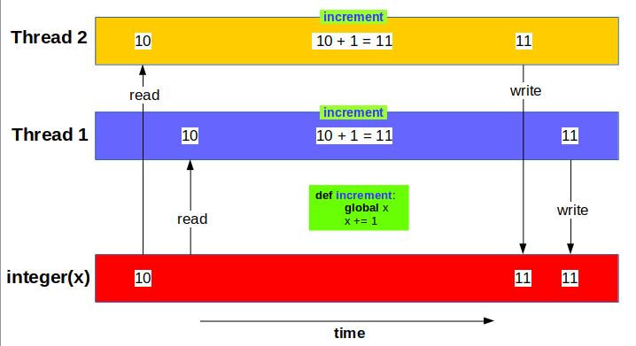
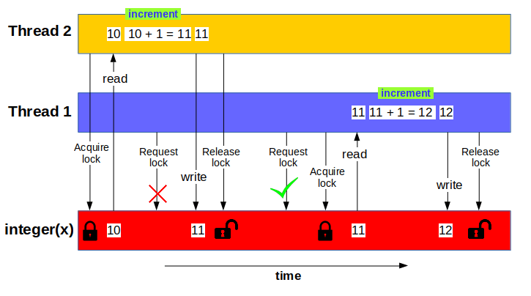
Potential Pitfalls of Multithreading:
Race Conditions and Deadlock
Source: https://indianpythonista.wordpress.com/2017/07/16/multithreading-in-python-part-2/
Source: https://indianpythonista.wordpress.com/2017/07/16/multithreading-in-python-part-2/
Correct Value: 12

Slide 5
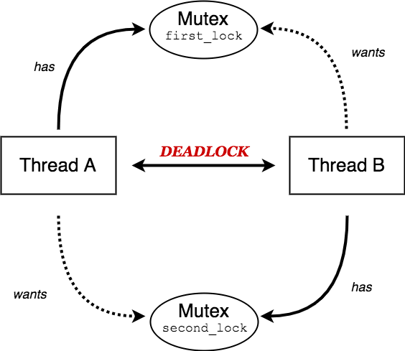
Potential Pitfalls of Multithreading:
Race Conditions and Deadlock
Source: https://indianpythonista.wordpress.com/2017/07/16/multithreading-in-python-part-2/
Source: https://dev.to/enether/working-with-multithreaded-ruby-part-i-cj3
Notes:
Mutex = Mutual Exclusion Object

Slide 6
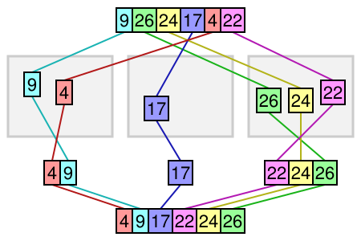
Bucket Sort:
Avoiding Race Conditions with Divide and Conquer Algorithms
Bucket elements do not overlap
Source: https://medium.com/karuna-sehgal/an-introduction-to-bucket-sort-62aa5325d124

Slide 7
Bucket Sort:
Avoiding Race Conditions with Divide and Conquer Algorithms
Uniformly distributed input is ideal
Choose buckets such that the number of elements in each is minimized
Insertion Sort
Merge sorted buckets in sequential order, O(n)
Source: https://medium.com/karuna-sehgal/an-introduction-to-bucket-sort-62aa5325d124

Slide 8
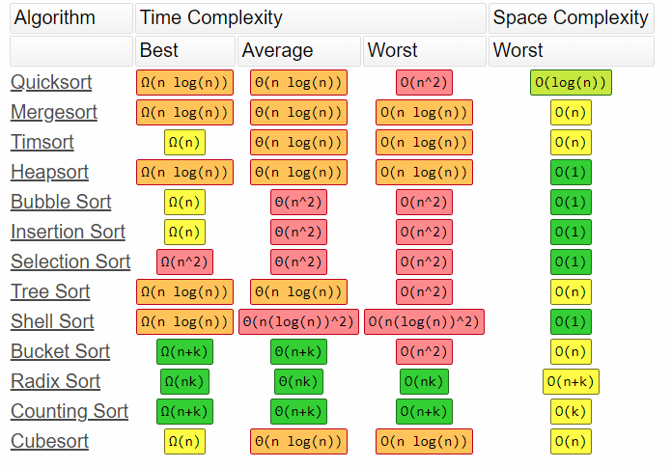
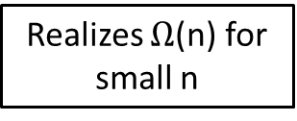
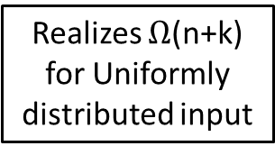
Why Bother Reducing the Execution Time of Bucket Sort?
Realizes $Ω$(n) for small n
Realizes $Ω$(n+k) for Uniformly distributed input
Source: http://bigocheatsheet.com/

Slide 9
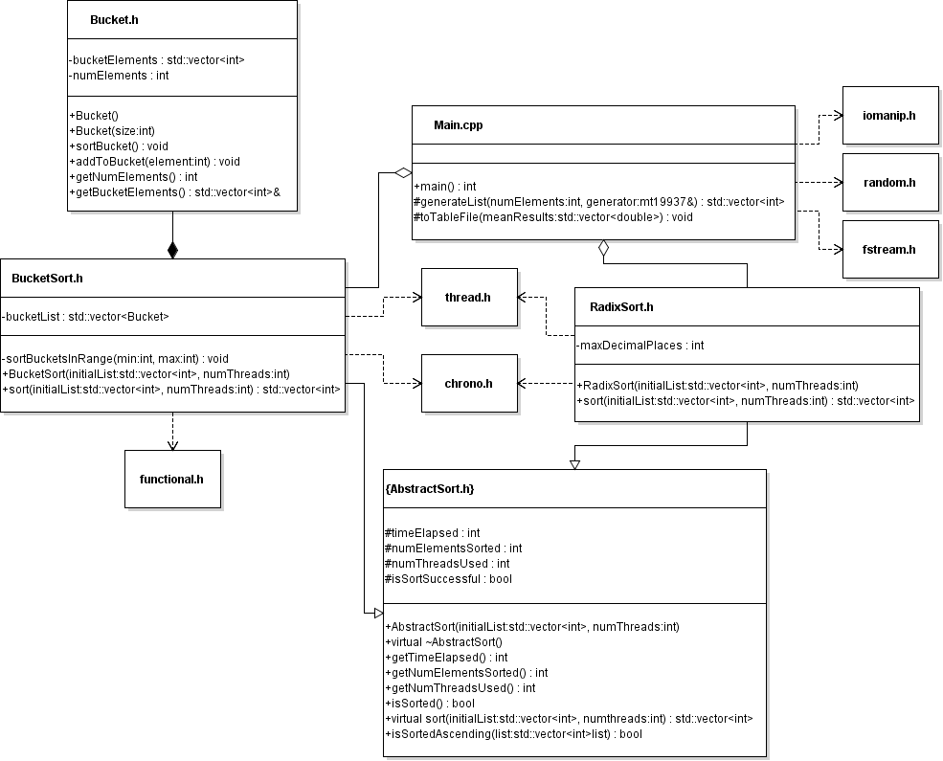
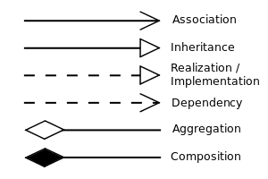
UML Class Diagram
Notes:
Aggregation: has-a, part can exist without the whole
Composition: has-a, part CANNOT exist without the whole
All depend on vector, but including that would’ve been messy

Slide 10
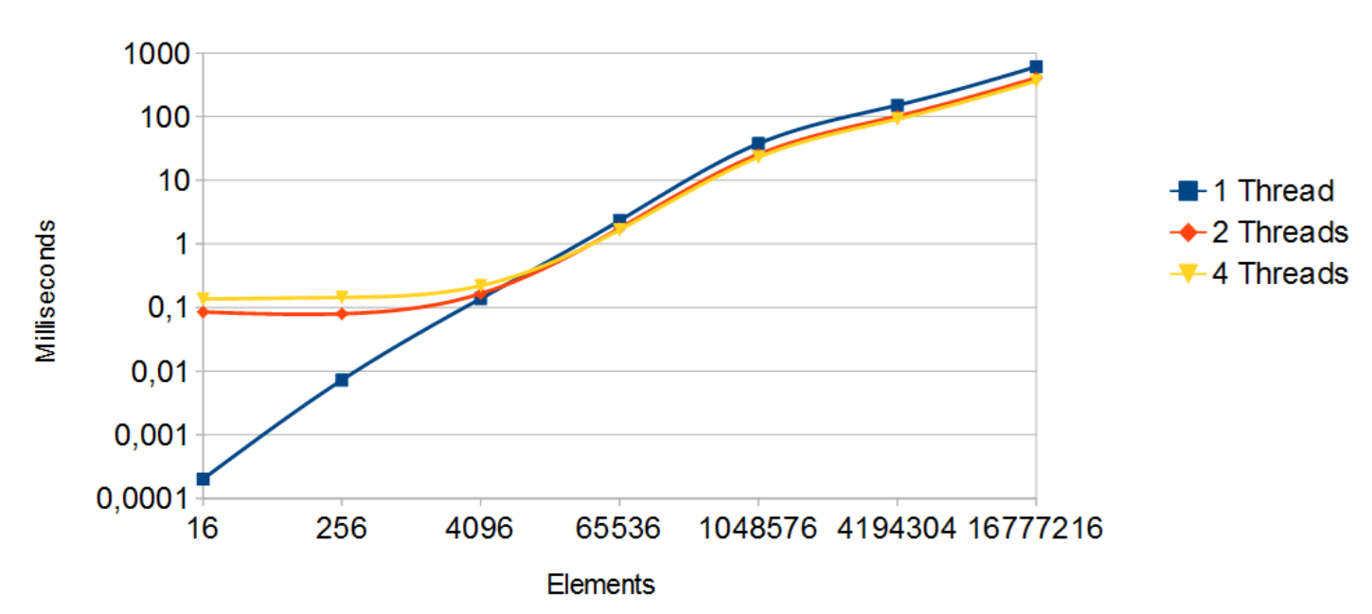
Mean Results Over 100 Trials
Execution Time (ms)
Elements | 1 Thread | 2 Threads | 4 Threads
16 | 0.0002 | 0.08 | 0.1
256 | 0.007 | 0.08 | 0.1
4096 | 0.1 | 0.2 | 0.2
65536 | 2.3 | 1.8 | 1.7
1048576 | 38 | 26 | 23
4194304 | 151 | 102 | 91
16777216 | 609 | 406 | 364
Source: Performance Analysis of Multithreaded Sorting Algorithms, Jouper and Nordin
Notes:
65,536 = 2^16
Intel i7: 4 cores/ 8 threads (has hyperthreading)
Intel i5: 4 cores/ 4 threads (doesn’t have hyperthreading)
441 lines of code

Slide 11
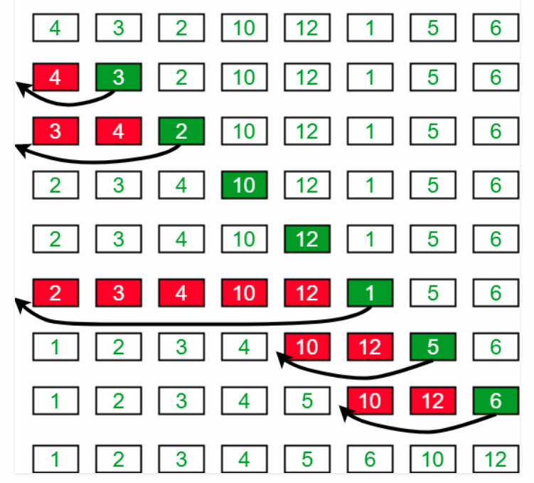
Insertion Sort
Source: https://www.geeksforgeeks.org/insertion-sort/
Notes:
Sorted like people sort a hand of cards

